Slide 1



Debt Recovery Analysis
View in Power BI
Last data refresh:
30/01/2023 09:10:25 UTC
Downloaded at:
30/01/2023 14:26:58 UTC

Slide 2
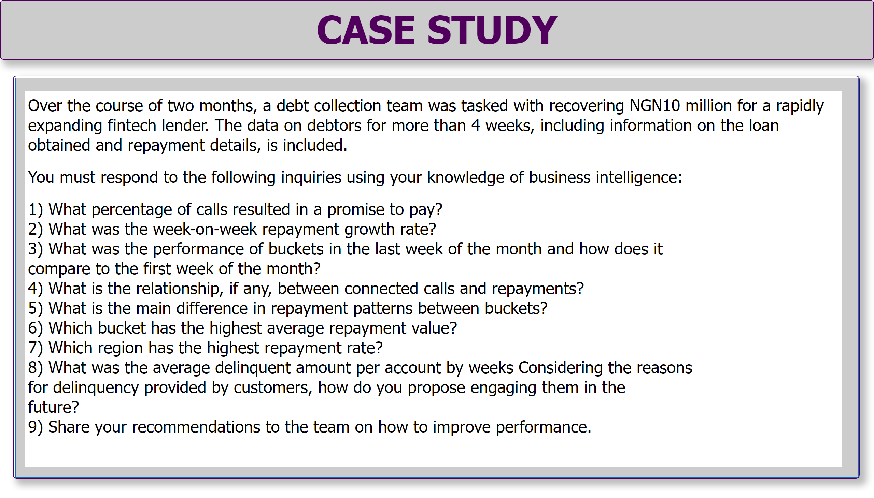
Page 1
Notes:
textbox
No alt text provided
shape
No alt text provided
textbox
No alt text provided

Slide 3
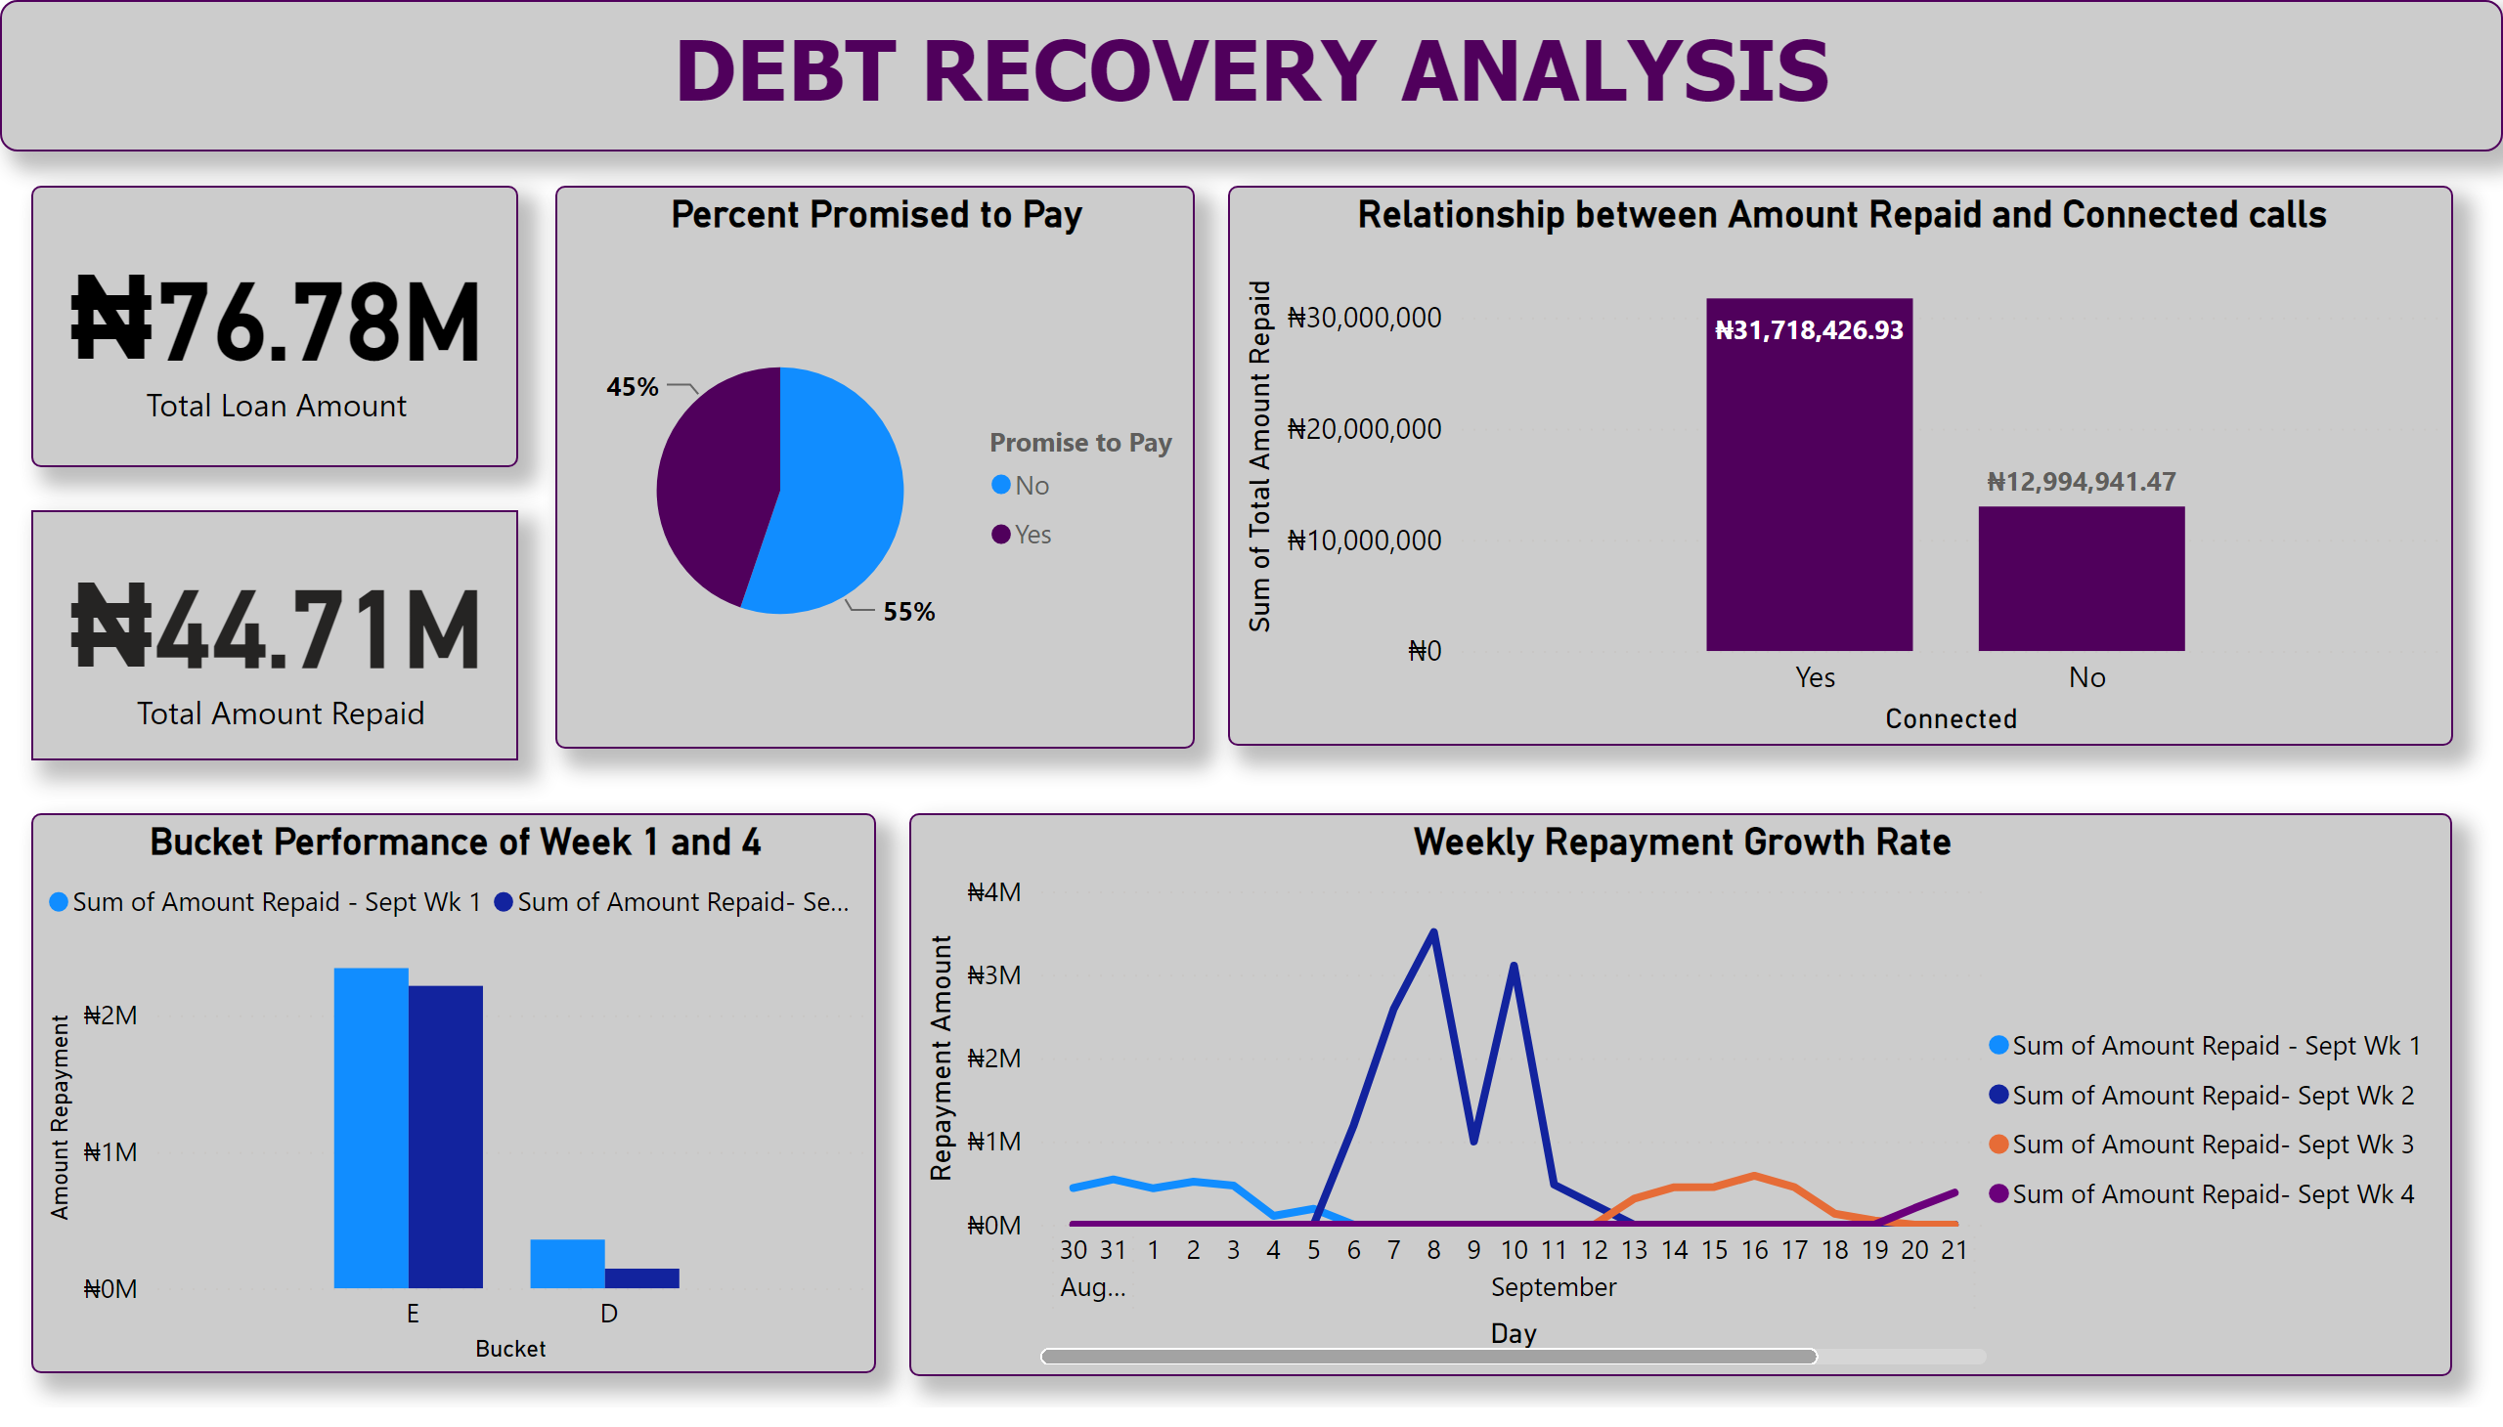
Page 2
Notes:
textbox
No alt text provided
Percent Promised to Pay
No alt text provided
Weekly Repayment Growth Rate
No alt text provided
Bucket Performance of Week 1 and 4
No alt text provided
Relationship between Amount Repaid and Connected calls
No alt text provided
card
No alt text provided
card
No alt text provided

Slide 4
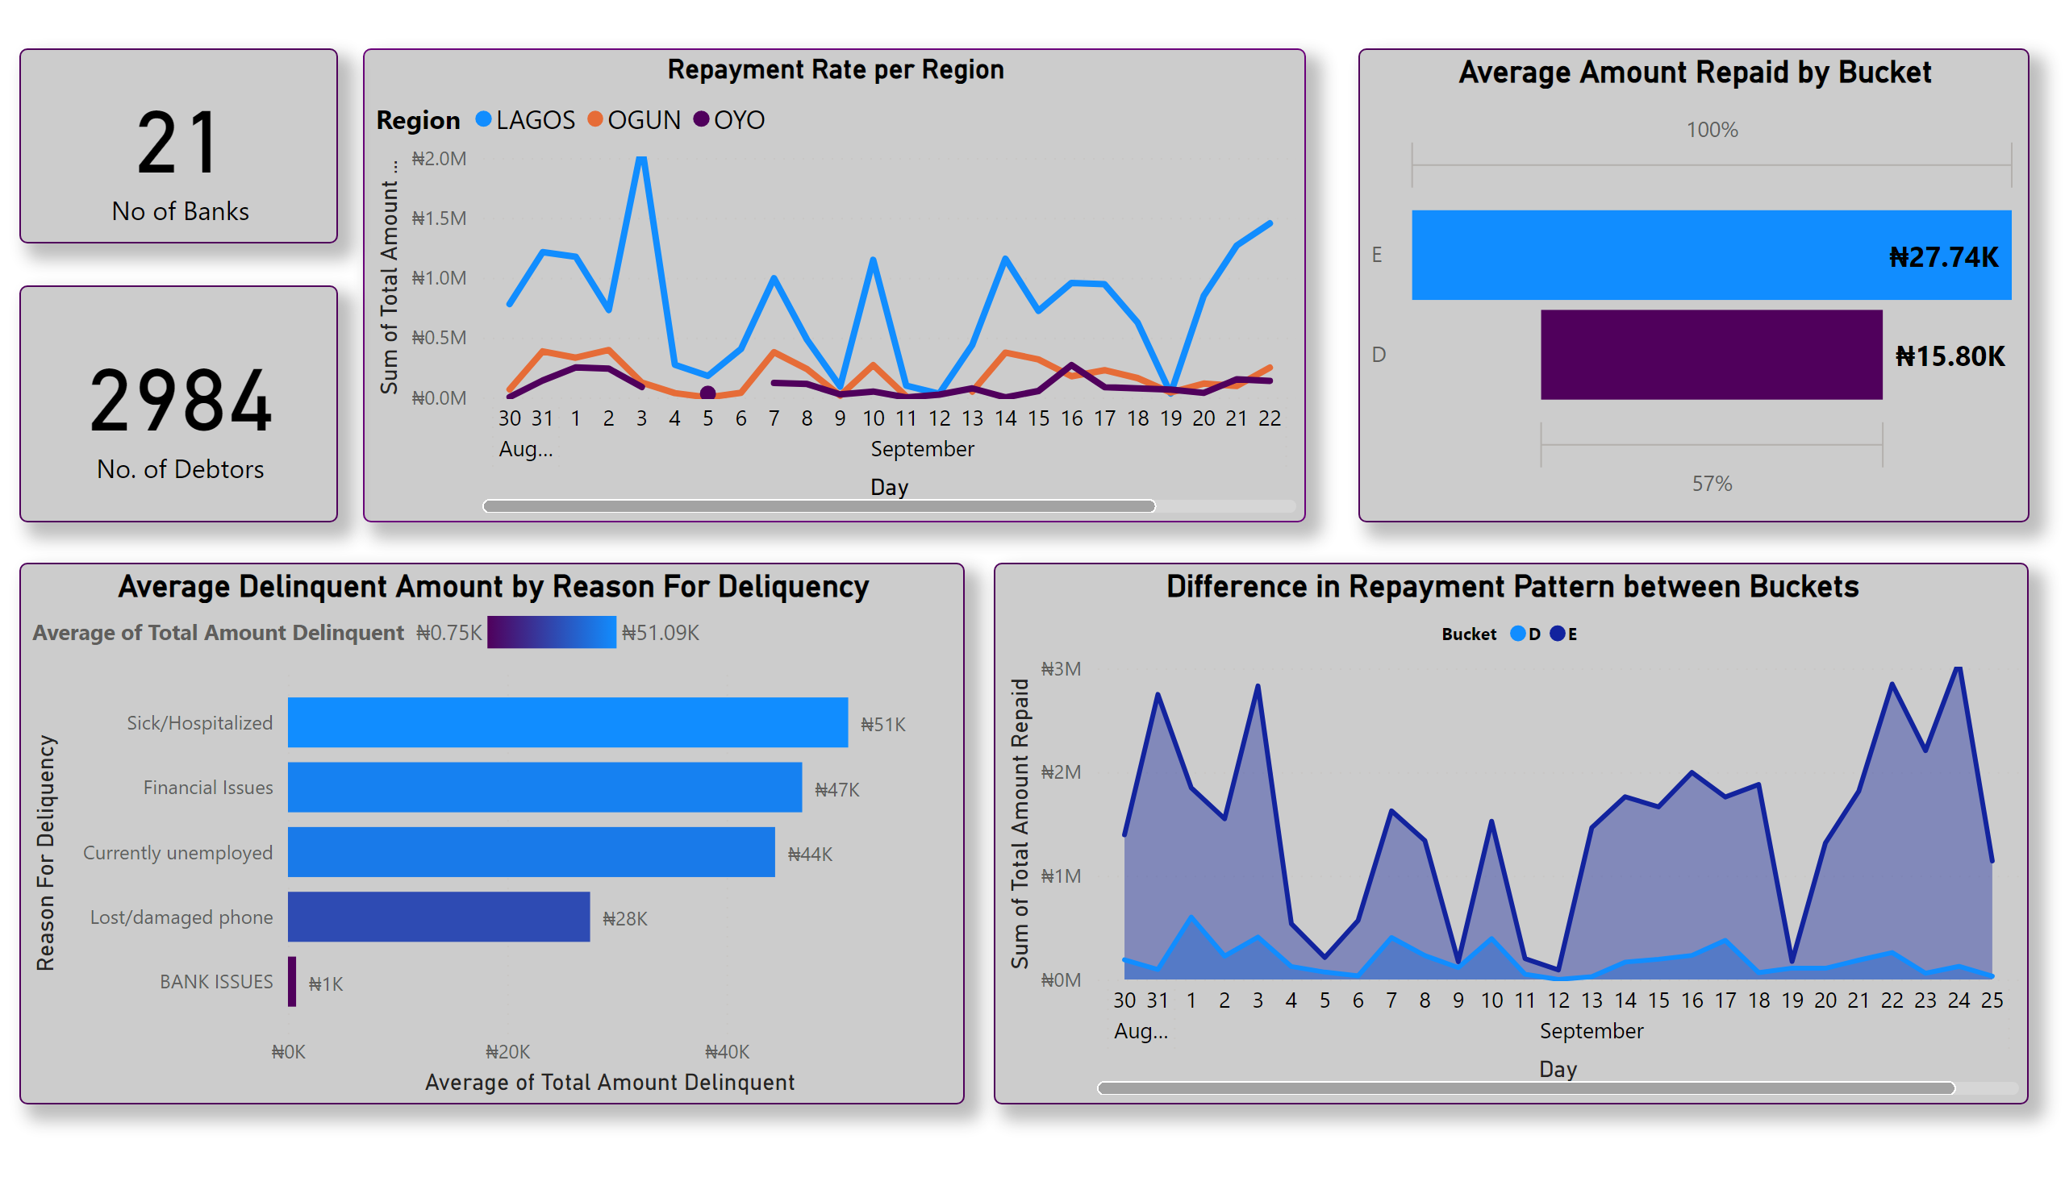
Page 3
Notes:
Repayment Rate per Region
No alt text provided
Average Amount Repaid by Bucket
No alt text provided
Average Delinquent Amount by Reason For Deliquency
No alt text provided
card
No alt text provided
card
No alt text provided
Difference in Repayment Pattern between Buckets
No alt text provided

Slide 5
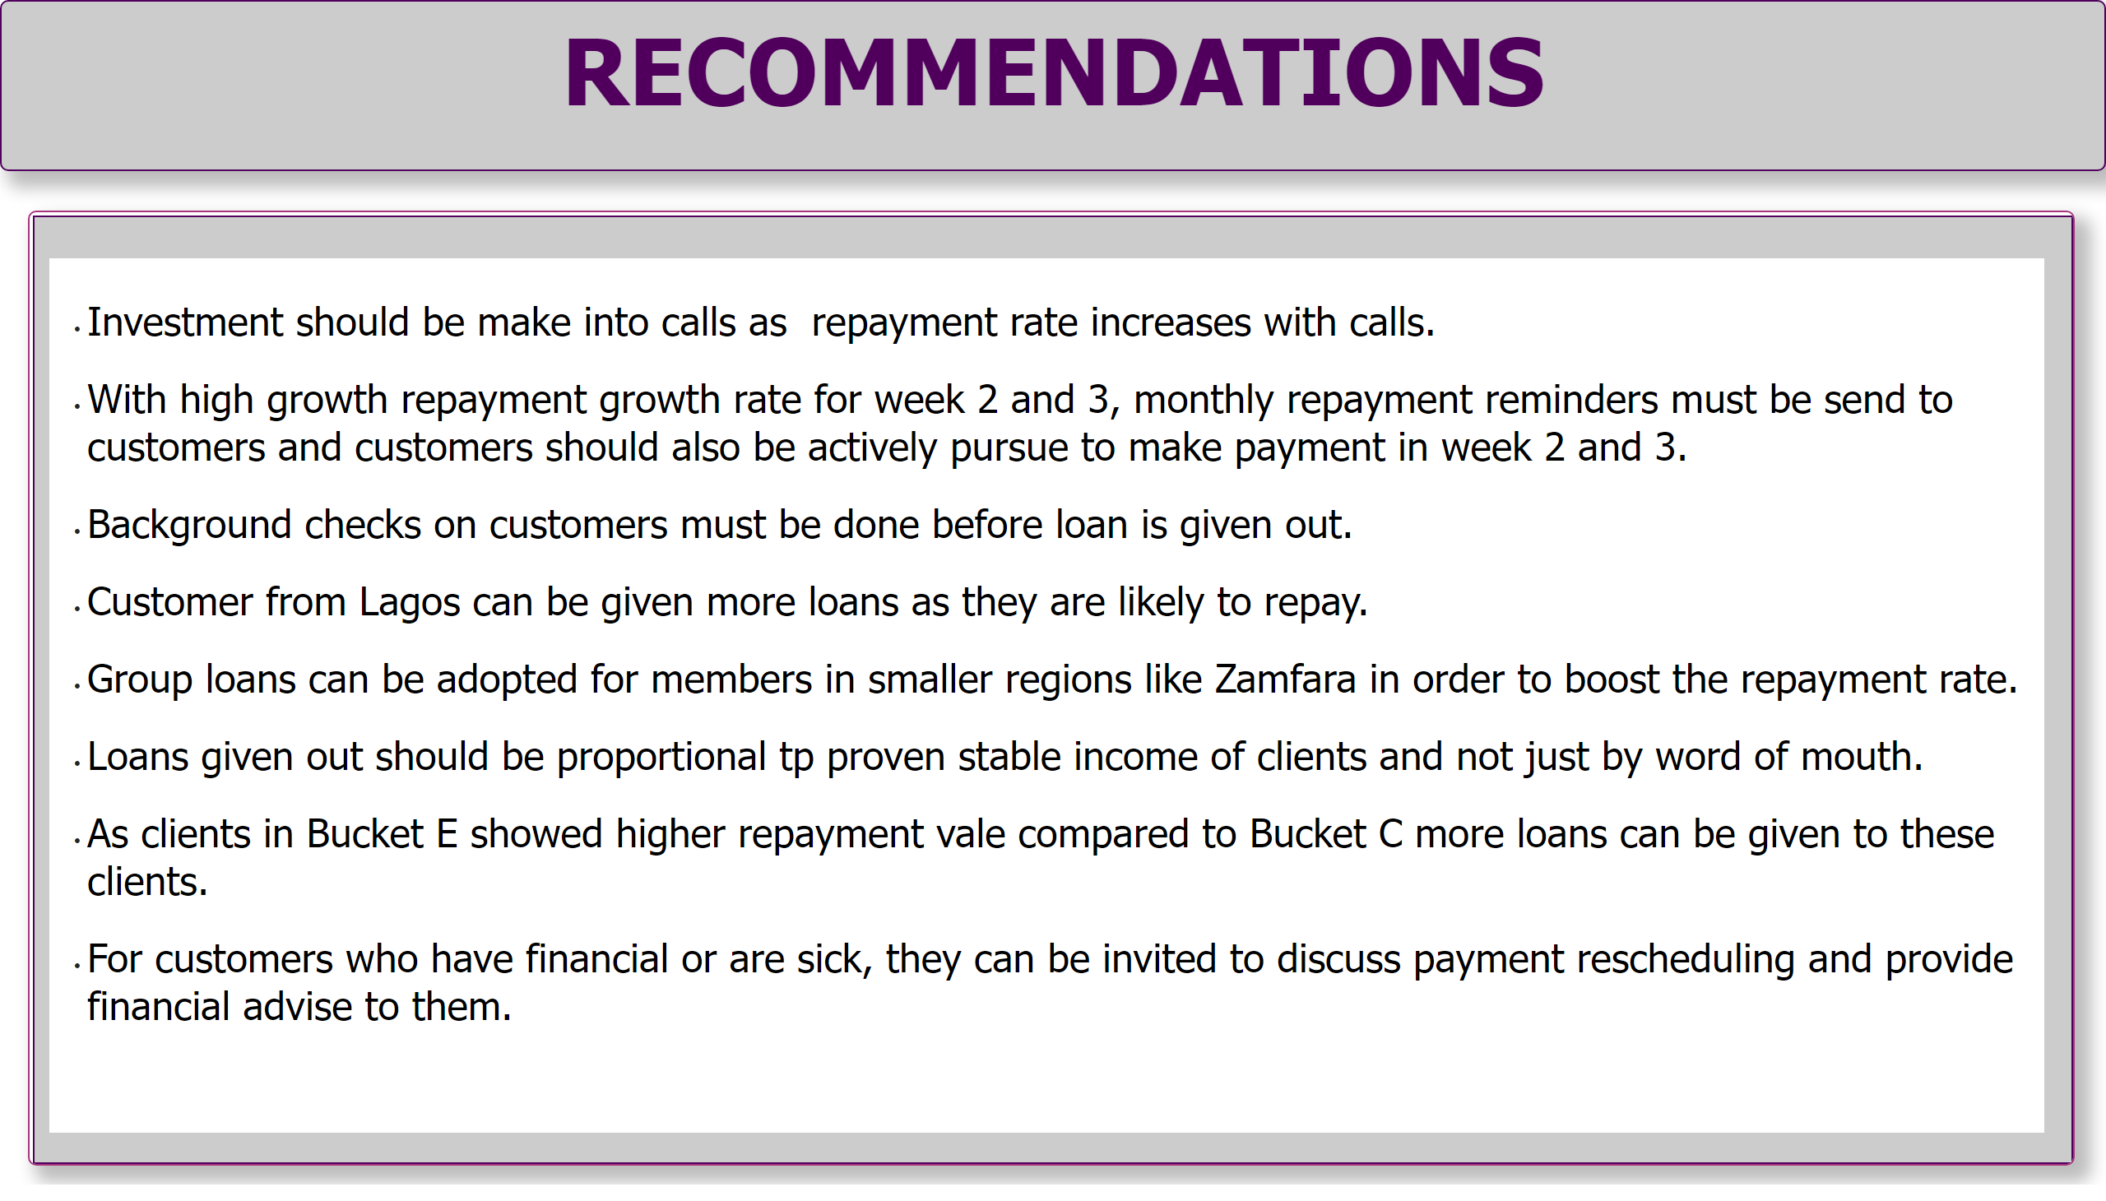
Page 4
Notes:
textbox
No alt text provided
shape
No alt text provided
textbox
No alt text provided

